Slide 1
While Loop

Slide 2
General Form
while (expression){
statement;
}

Slide 3
General Form
while (expression){
statement;
}
As in the if-else control structure, the boolean expression must be enclosed in parentheses ().

Slide 4
General Form
while (expression){
statement;
}
If the expression is true, the statement is executed.
After execution of the statement, program control returns to the top of the while construct.
The statement will continue to be executed until the expression evaluates to false.

Slide 5
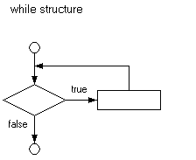
Flow Diagram
while (expression){
statement;
}

Slide 6
While Loop - Example
int number = 1; // initialize
while (number <= 10){ // loop boundary condition
System.out.println(number);
number++; // increment/decrement
}

Slide 7
While Loop - Example
You must initialize the loop control variable.
If you do not, Java produces an error message warning you that the variable may not have been initialized.
int number = 1;
while (number <= 10){
System.out.println(number);
number++;
}

Slide 8
While Loop - Example
Loop Boundary Conditional
Make sure that you have the correct comparison and that the boundary value is correct.
(<, >, ==, <=, >=, !=)
int number = 1;
while (number <= 10){
System.out.println(number);
number++;
}

Slide 9
While Loop - Example
Make sure to go towards the boundary condition loop so the loop eventually terminates.
Otherwise the program will get stuck in an infinite loop and never end!
int number = 1;
while (number <= 10){
System.out.println(number);
number++;
}

Slide 10
While Loop - Example
It is possible for the body of a while loop to execute zero times.
int number = 100;
while (number <= 10){
System.out.println(number);
number++;
}

Slide 11
Loop Boundaries

Slide 12
Loop Boundary
The loop boundary is the boolean expression that evaluates as true or false.
It must eventually become false, exiting the loop.
It must be related to the task of the loop. Once done, the loop boundary must become false.

Slide 13
Loop Boundary
Output:
0
2
4
6
8
10
12
14
16
18
20
int x = 0;
while (x < 22){
System.out.println(x);
x += 2;
}

Slide 14
Do While Loop

Slide 15
do-while loop
A do-while loop guarantees the inside of the loop is executed. It then executes an exit expression at the end of the loop.

Slide 16
do-while loop – Set Up
do{
statement;
}while (expression);

Slide 17
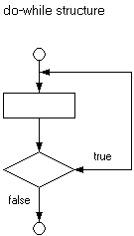
do-while loop – Set Up

